Slide 1

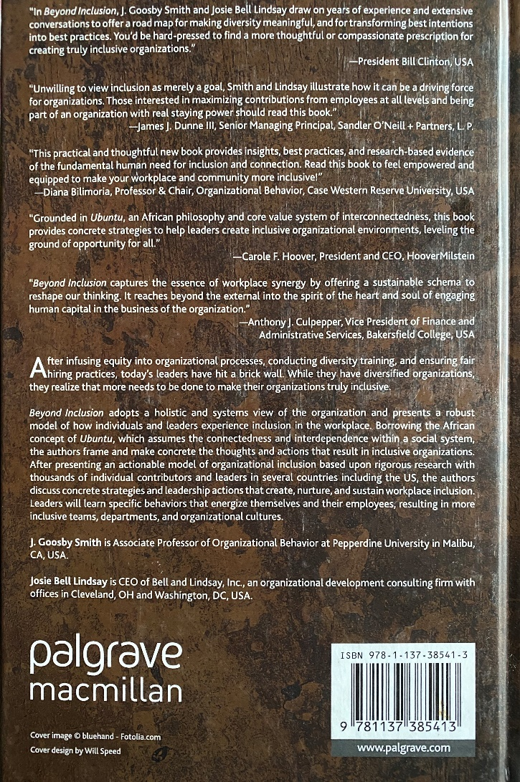
Creating Inclusive Organizations
DEVOPS Enterprise Summit – Las Vegas, NV
J. Goosby Smith, PhD, MBA – October 13-15, 2020
Notes:
https://www.themorningsun.com/news/mr-appliance-of-mt-pleasant-provides-central-michigan-area-with-appliance-services/article_fae67278-28c9-11ea-b832-eb7ce7a0249c.html

Slide 2
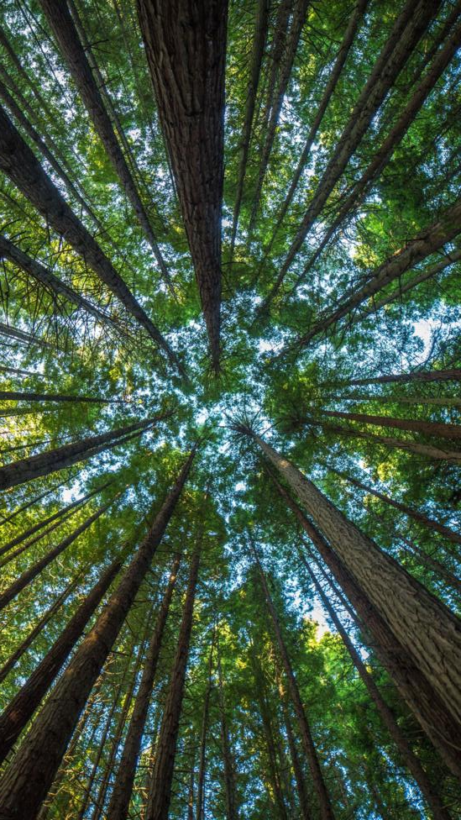
Today’s Agenda
Introduction & Overview
Gardening
Definition of Variables
Creating Inclusive Organizations
What can YOU do?
Wrap-Up

Slide 3





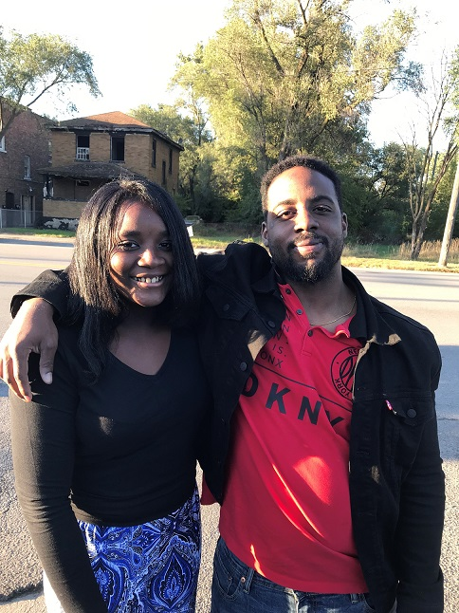
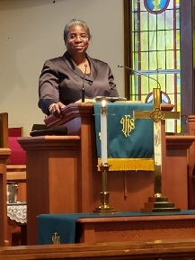

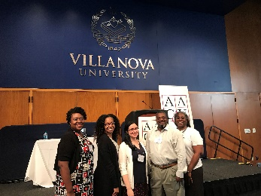
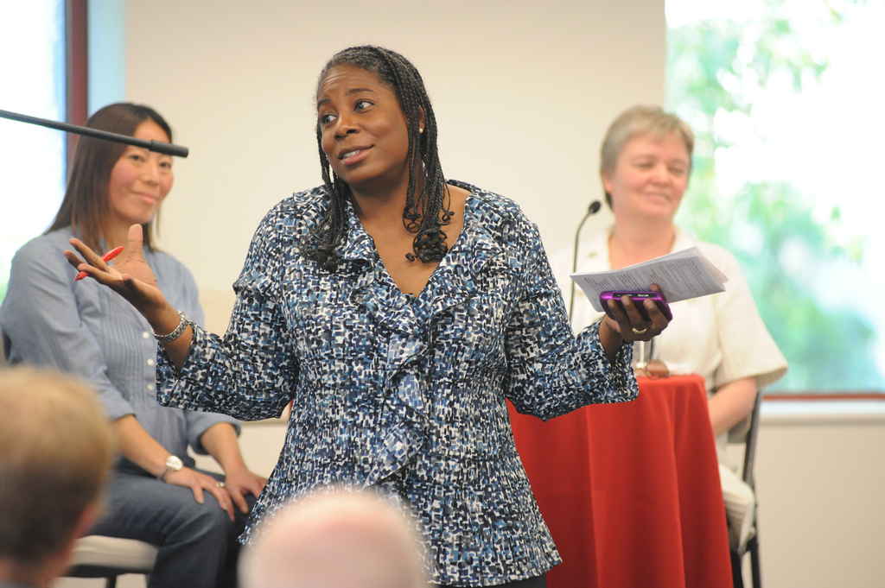
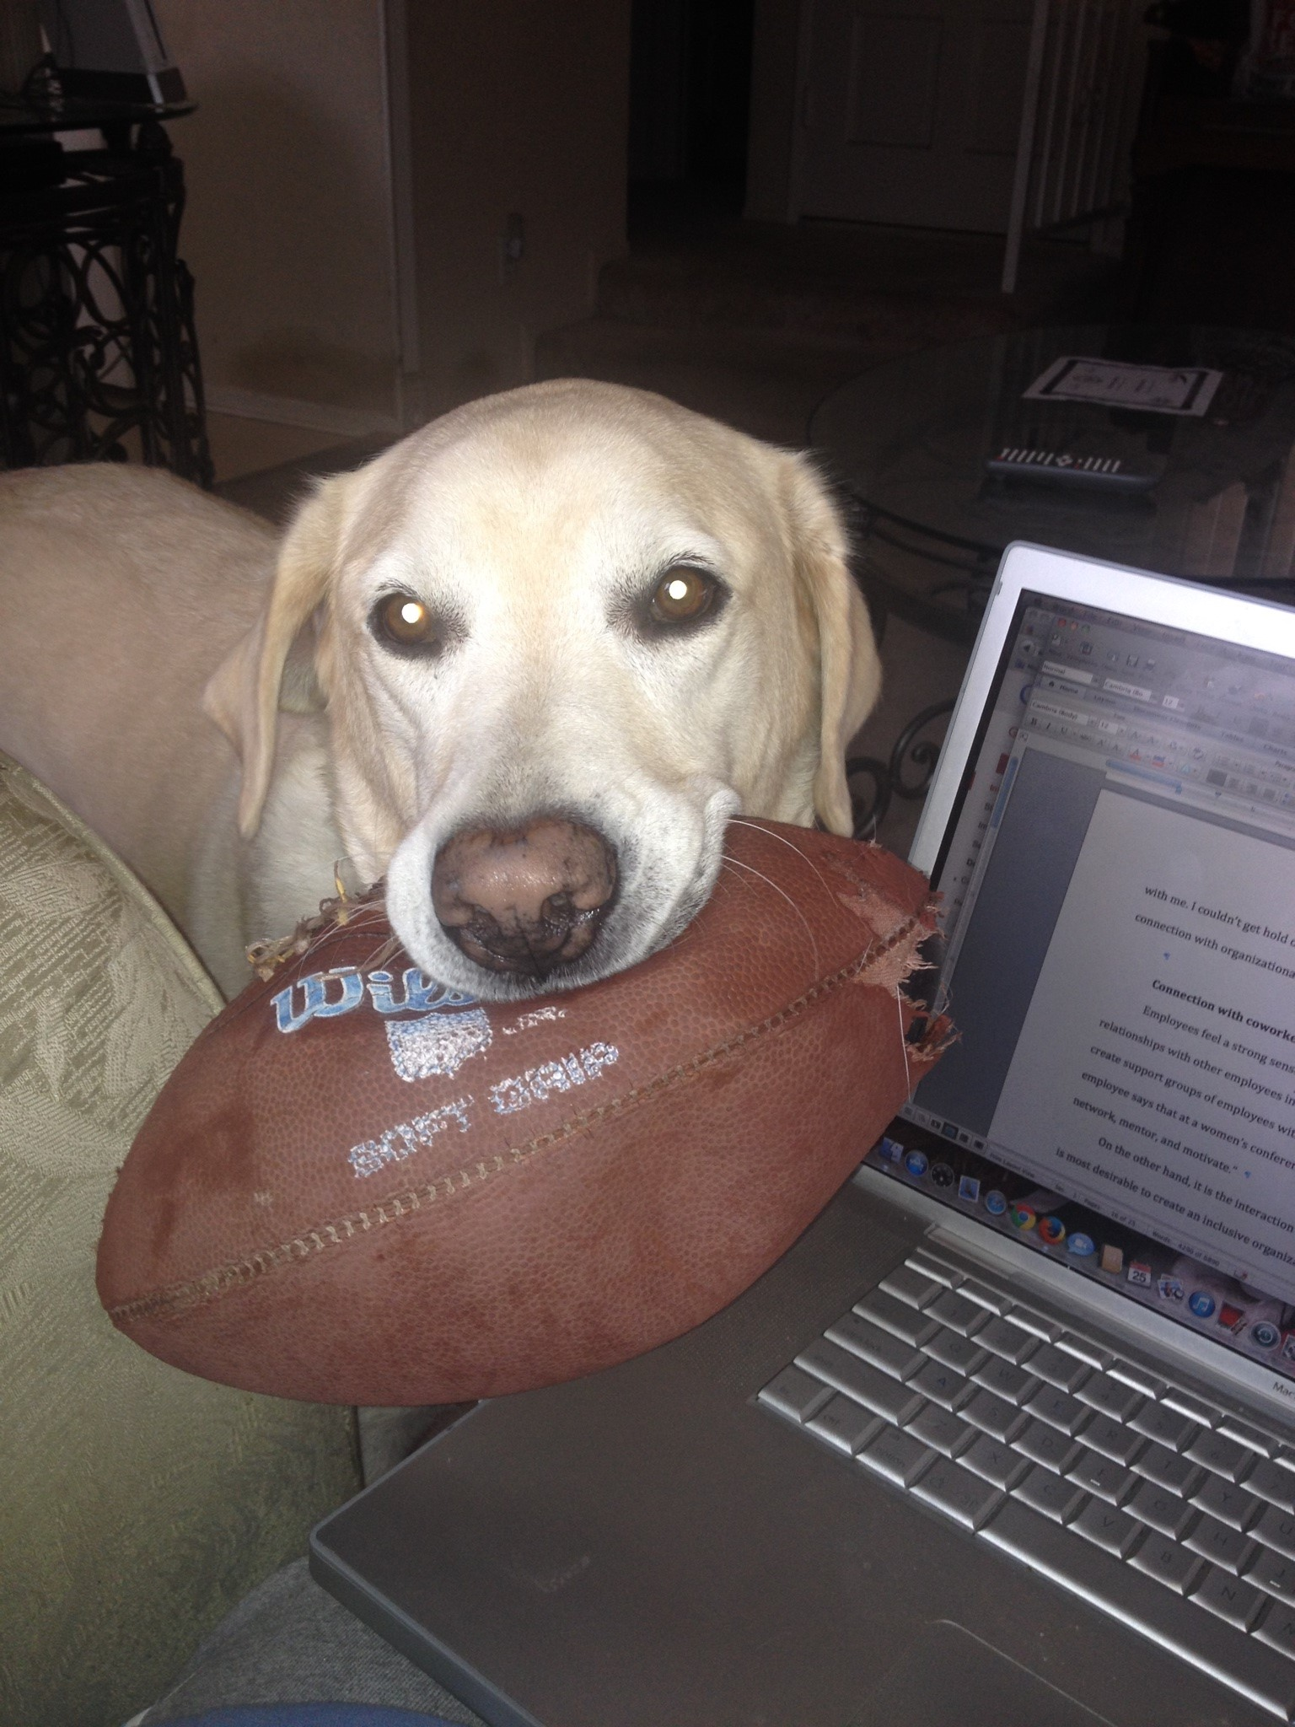
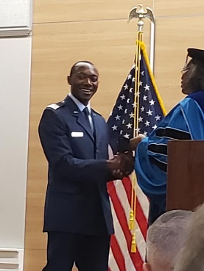
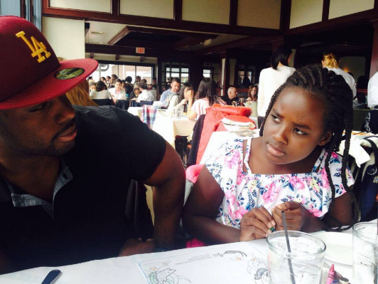

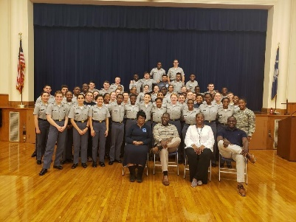
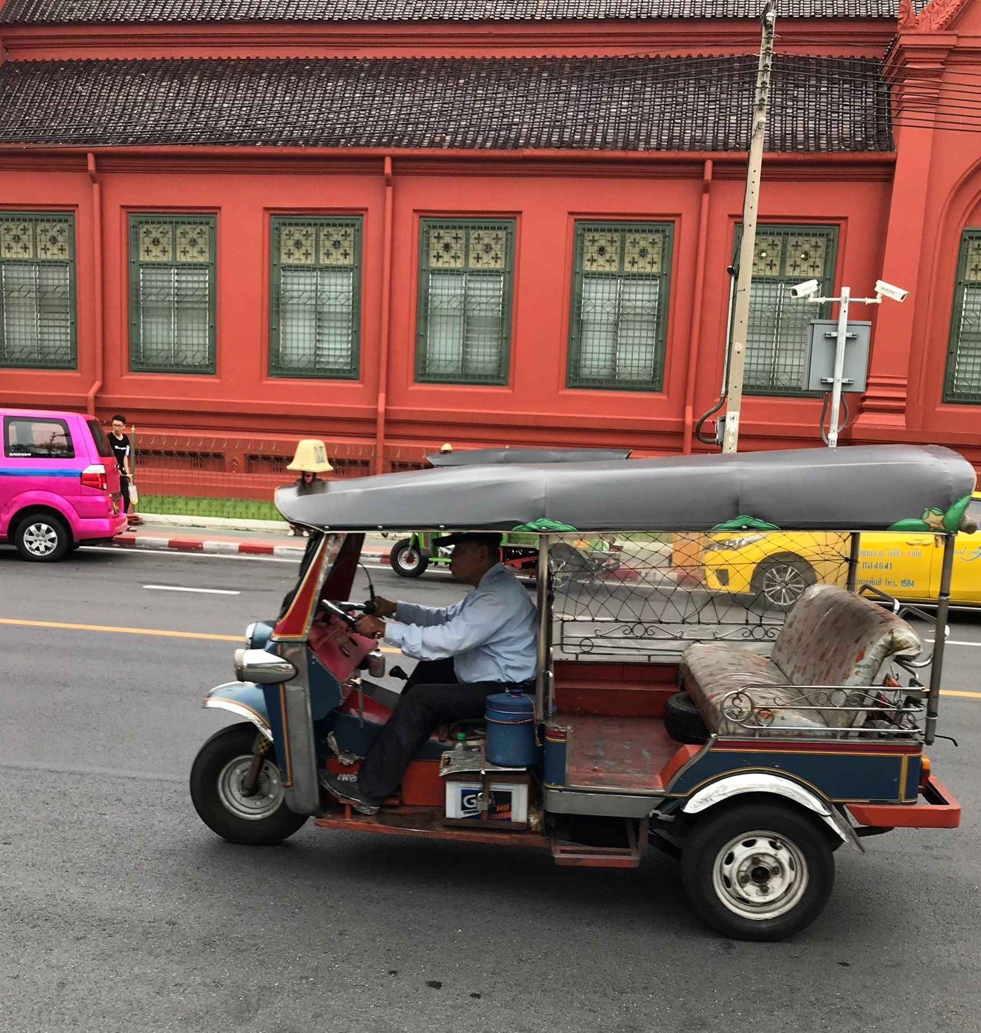
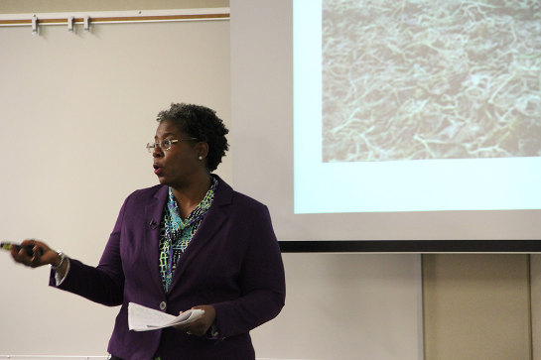
















“Dr. J”
(c) 2019 J. Goosby Smith, Ph.D.

Slide 4
The Big Picture
Good developers have clear variable definitions!
Diversity
Equality
Equity
Inclusion

Slide 5

Your Organization

Slide 6
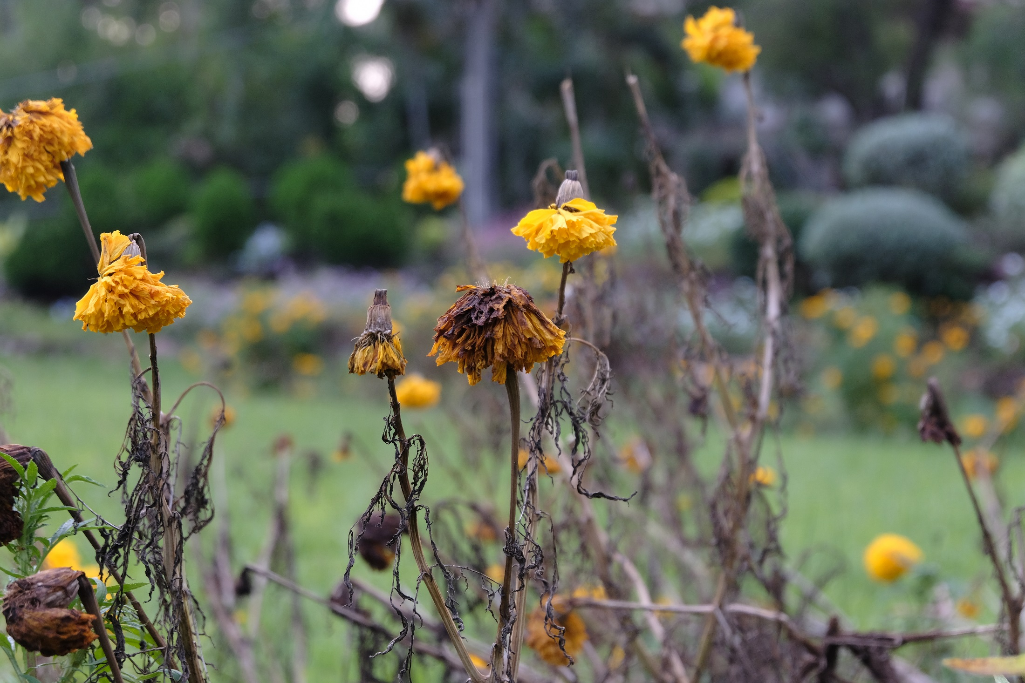
A very diverse but not very inclusive “Organization”

Slide 7
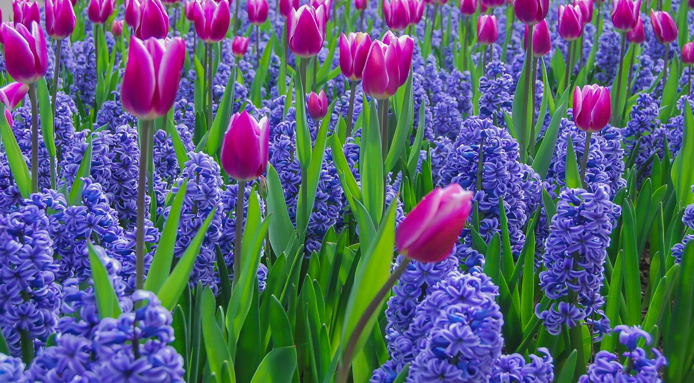
A very inclusive but not very diverse “Organization”

Slide 8
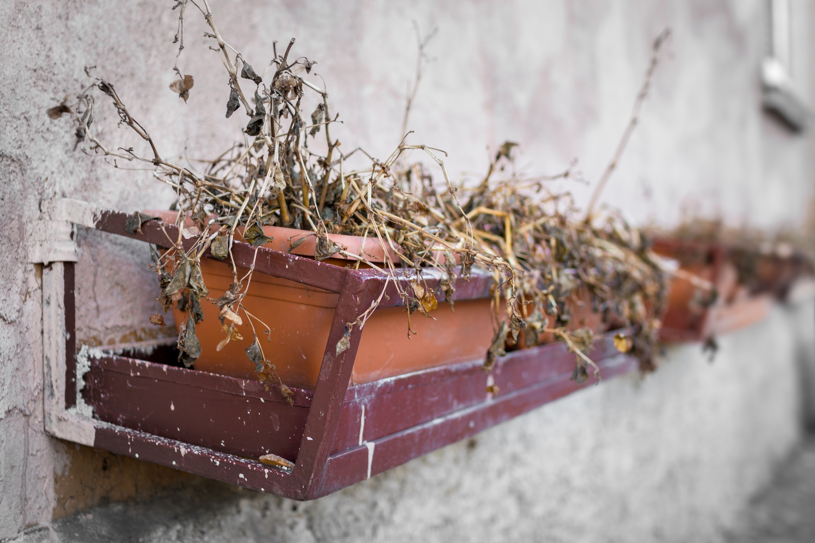
A not very diverse and not inclusive “Organization”

Slide 9
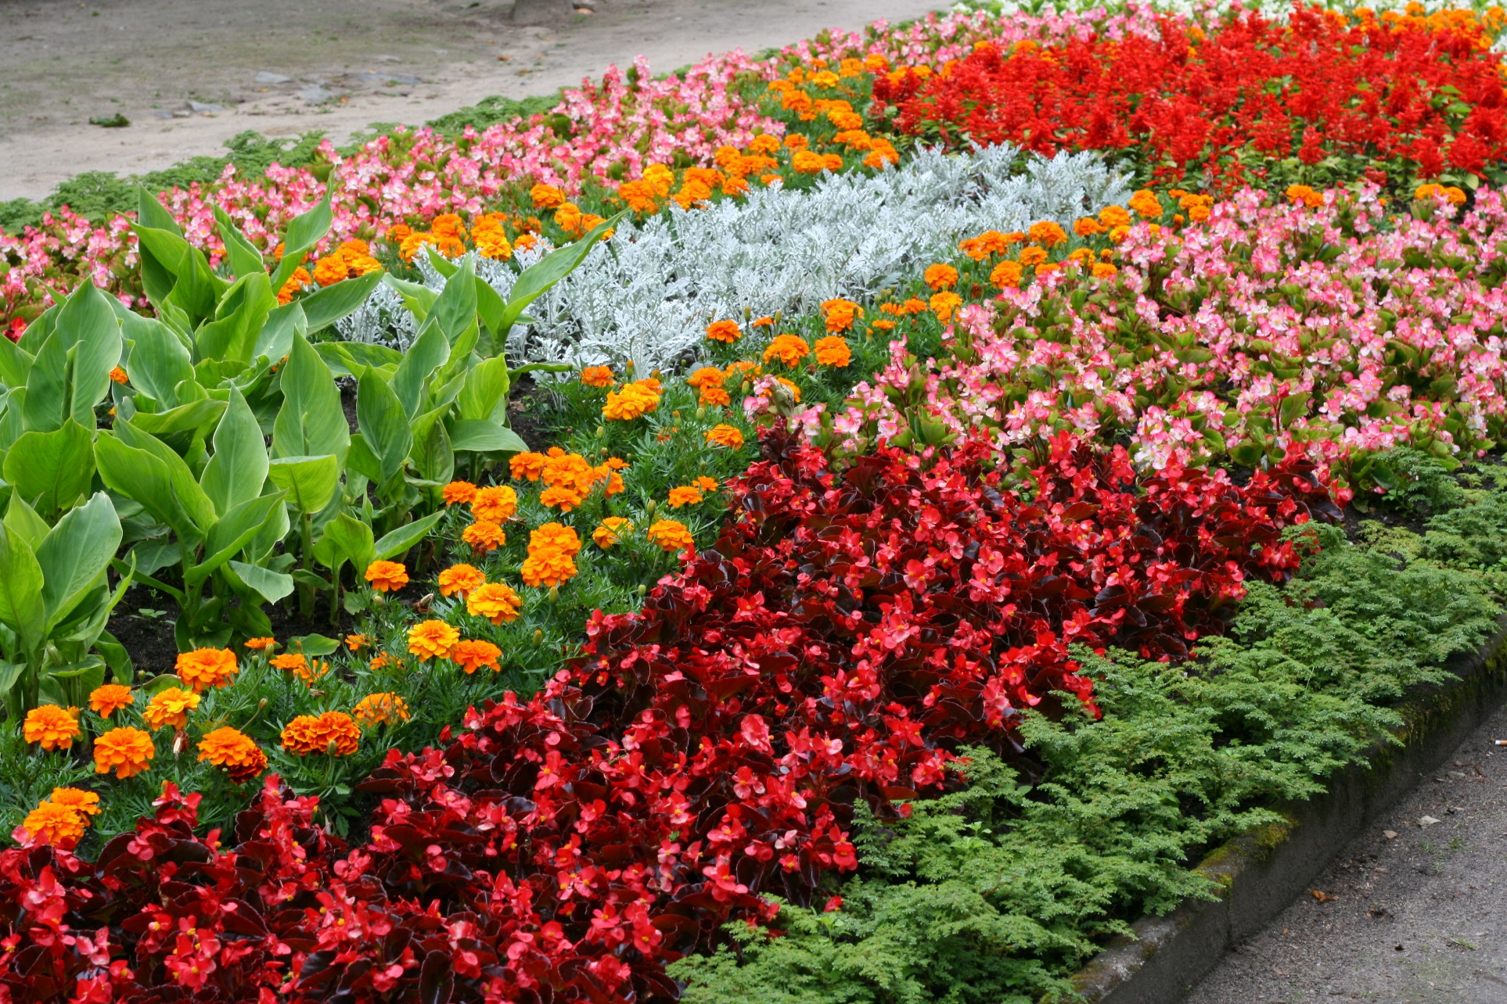
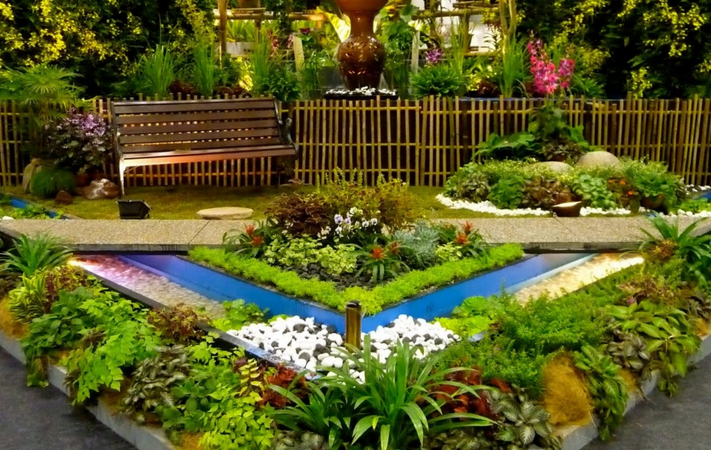
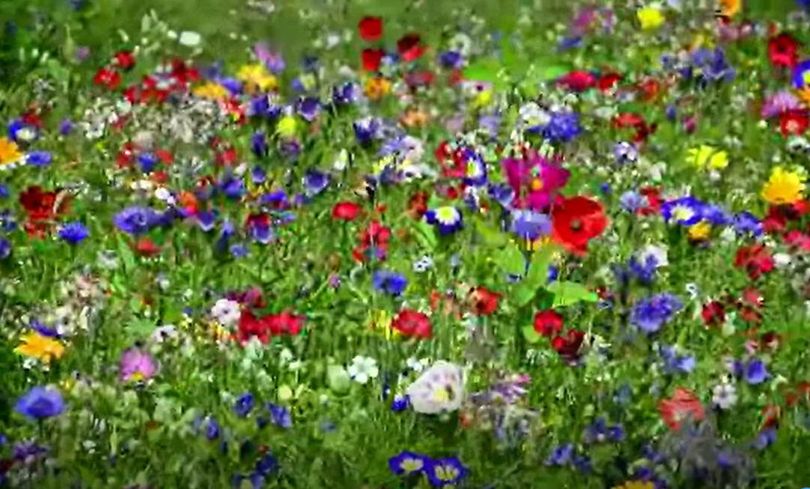
Our goal: Very diverse and inclusive organization
Notes:
http://lomets.com/pin/flowers-in-garden-edges/

Slide 10
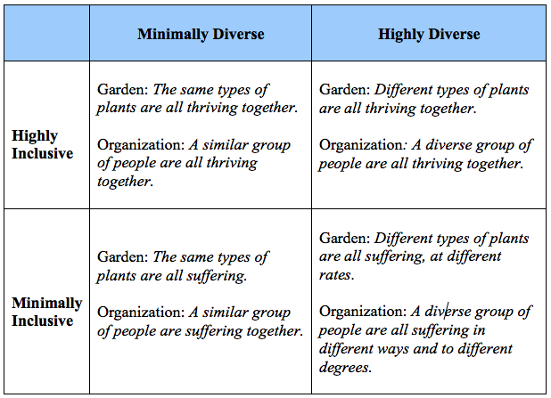
In sum: Inclusion and Diversity are DIFFERENT
https://gbr.pepperdine.edu/2017/08/the-garden-an-organismic-metaphor-for-distinguishing-inclusion-from-diversity/

Slide 11
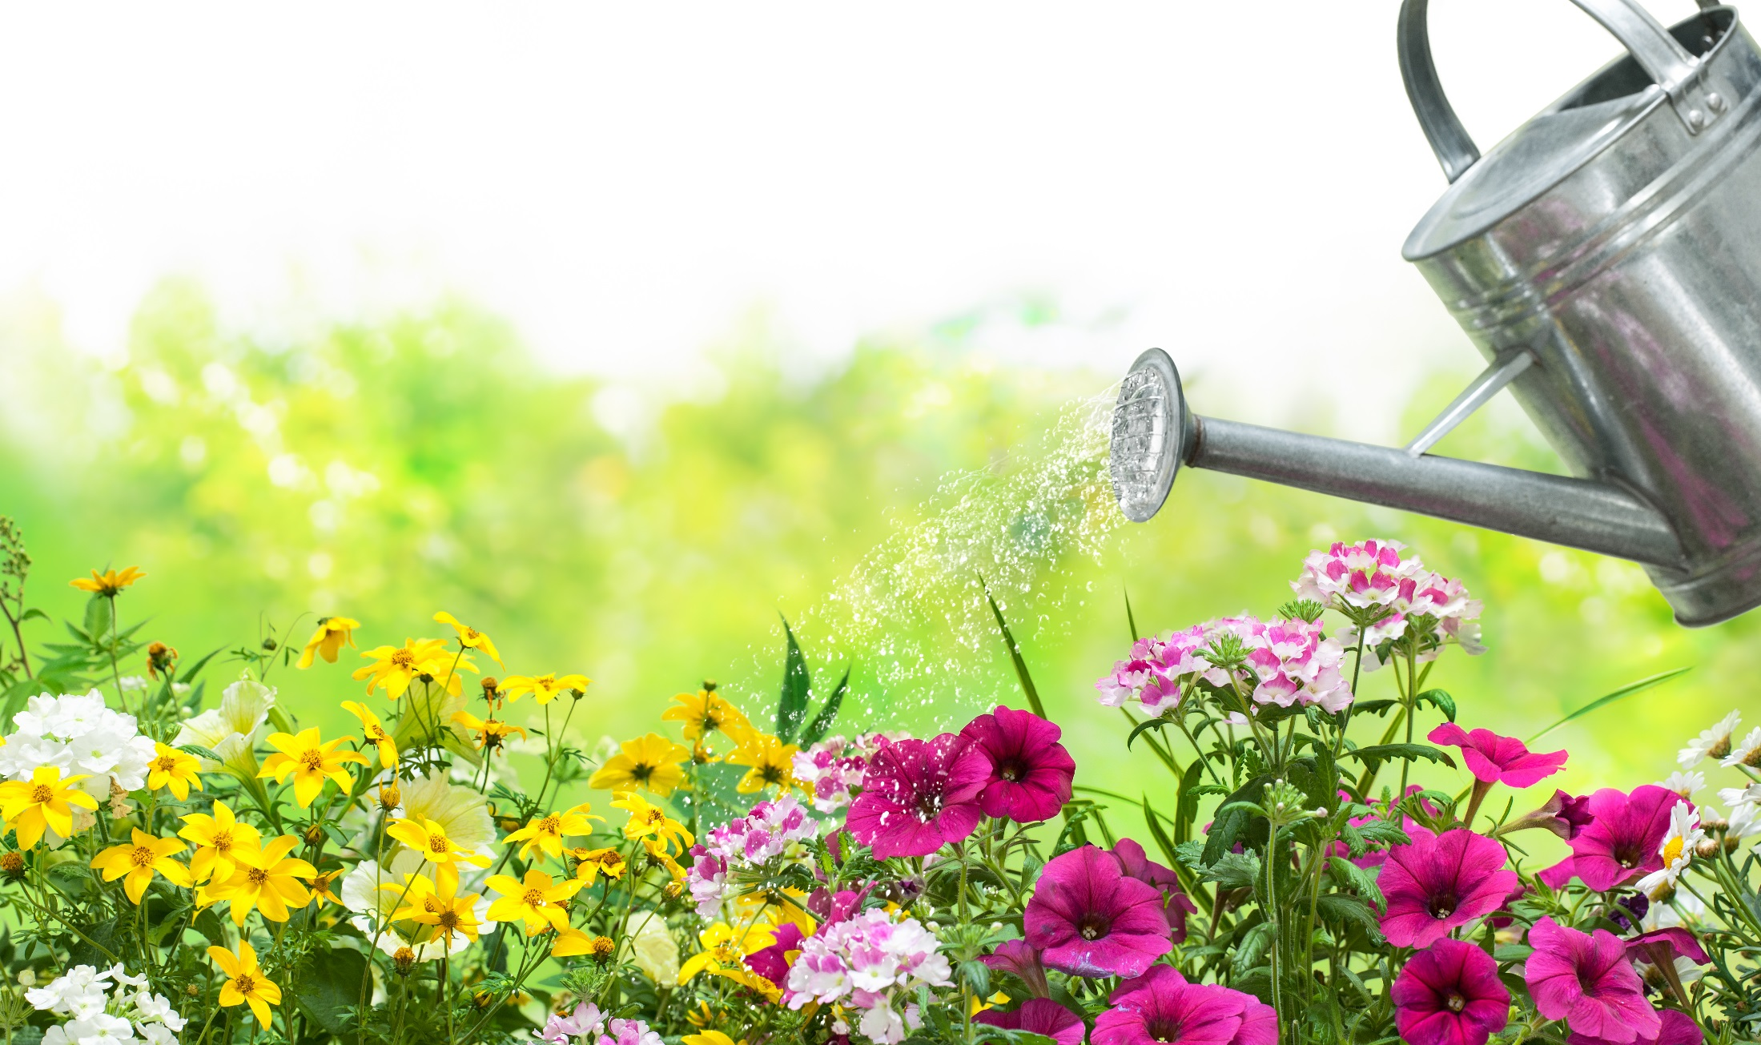
Equality

Slide 12
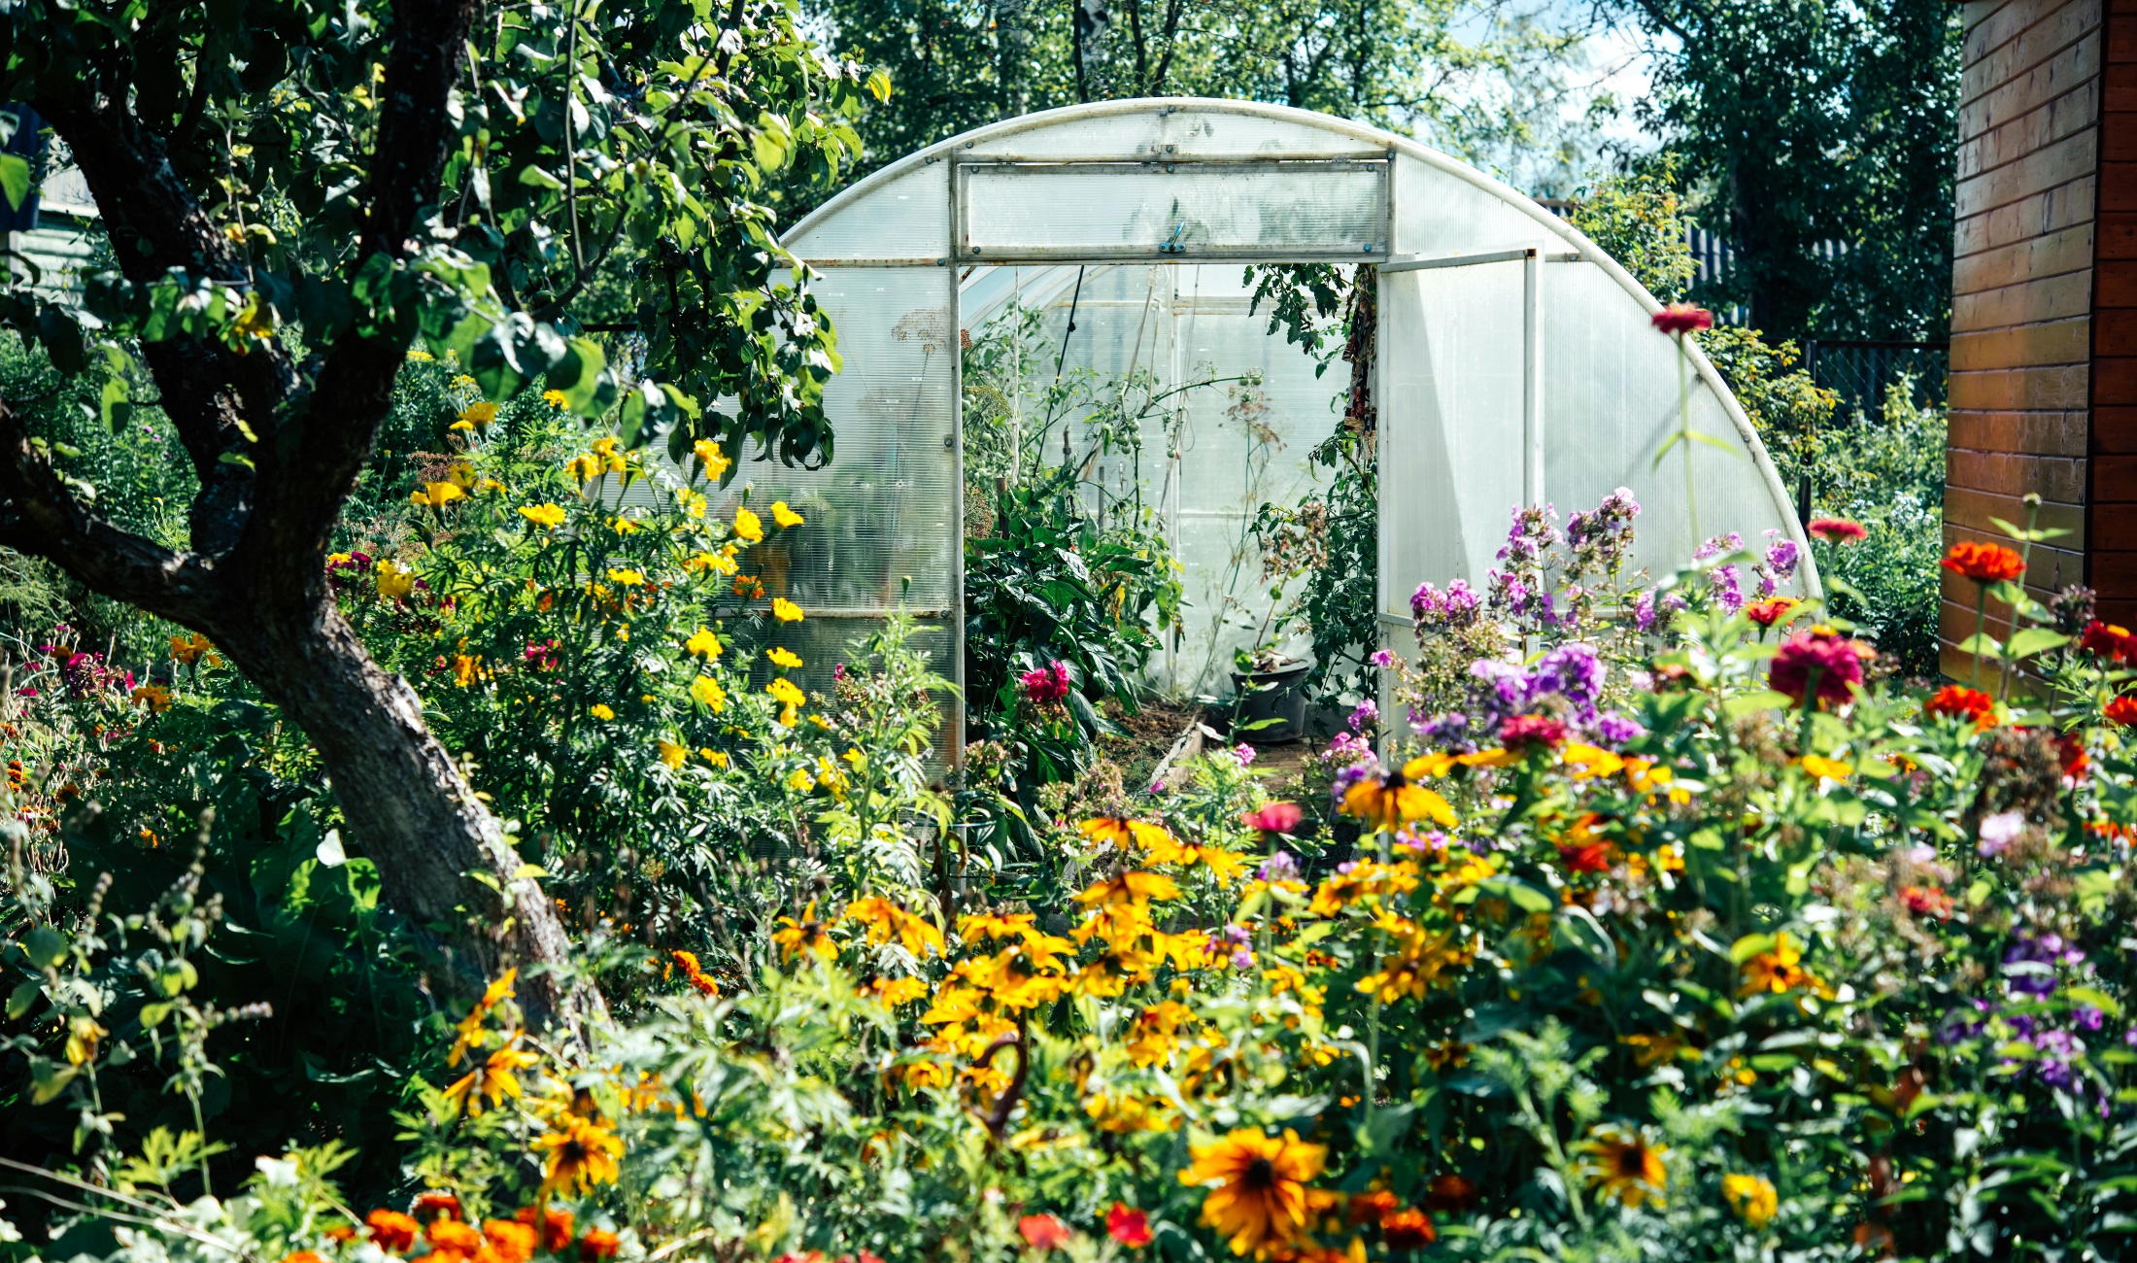
Equity
Equity

Slide 13
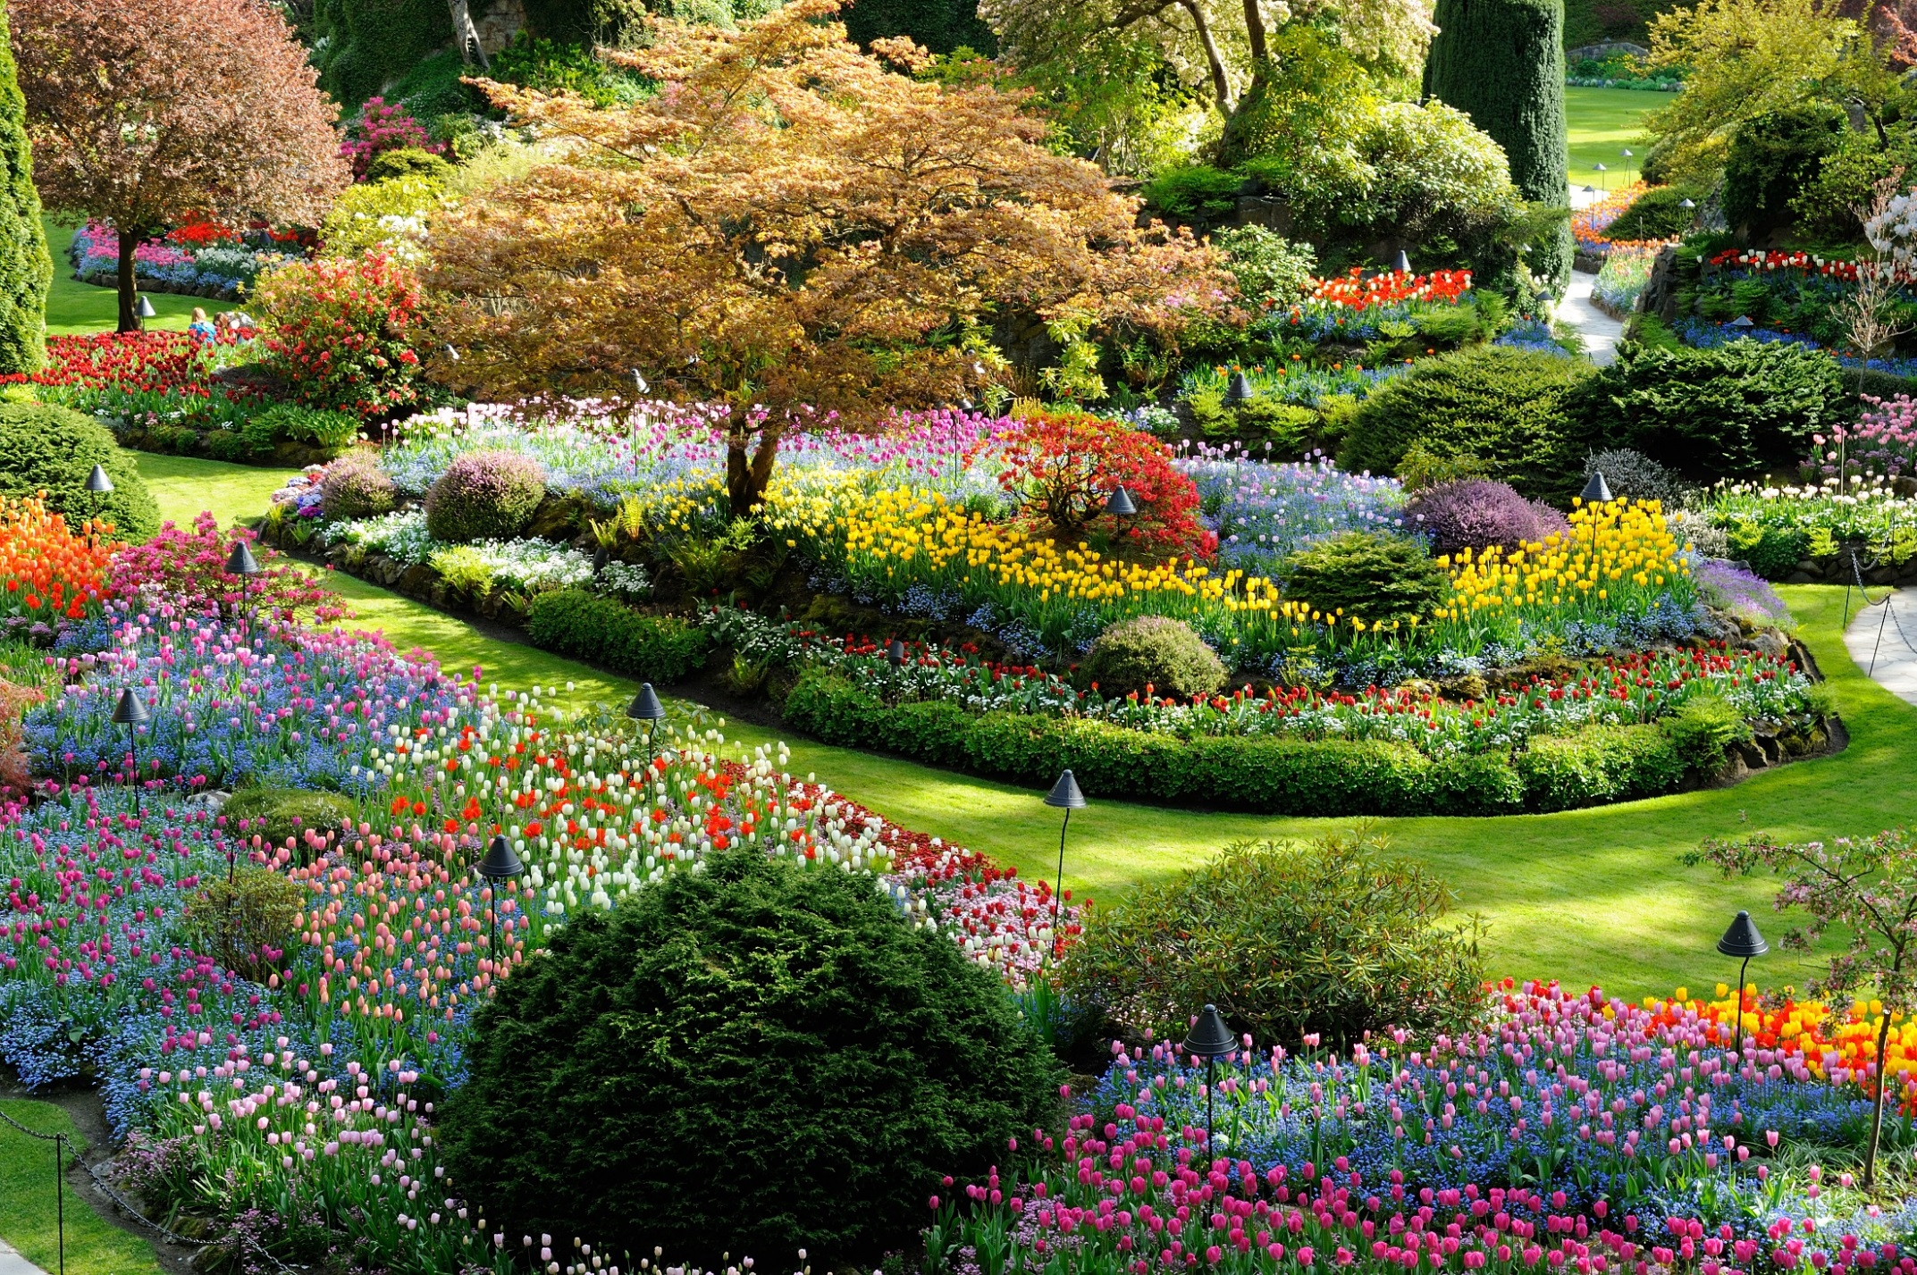
Equity
Looking Deeper at Diversity

Slide 14
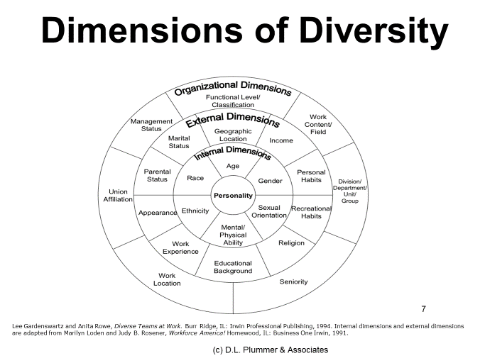
“Roots”
Learning style
Personality
Leadership style
Circadian rhythm
Career needs
Conflict
Diversity is a complicated variable. “Both-and” thinking is best.
We human flowers are complex “hybrids”!

Slide 15
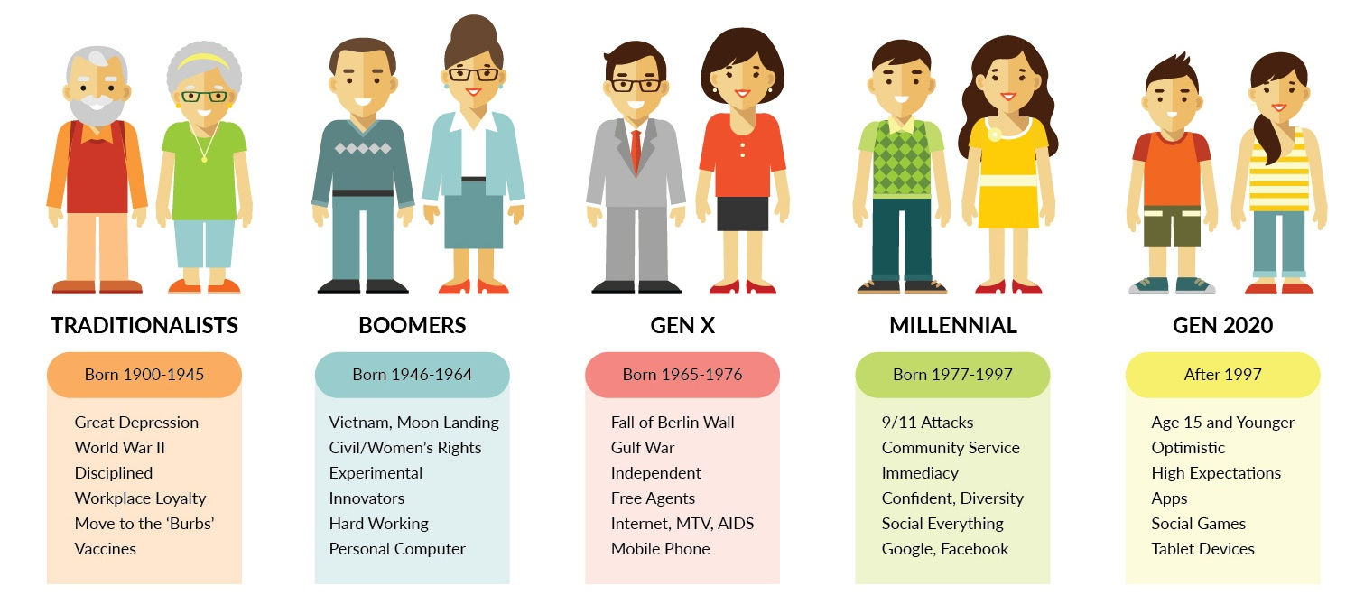
Different flowers, different needs
AKA Gen Y
AKA Gen Z

Slide 16

Coming soon to the marketplace…

Slide 17
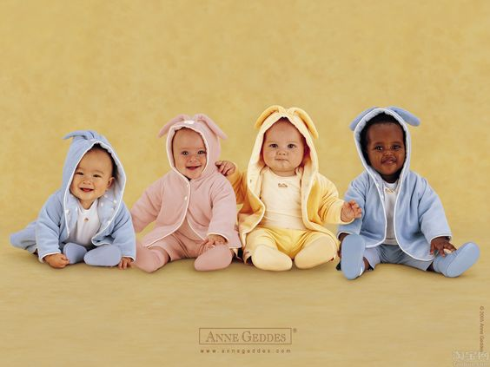
Please meet: Generation Alpha!
Born 2010-2025
First generation born entirely in the 21st century
Parents are the 22 million Millennials (birth rate about 9000/day)
2.5 million Gen Alpha babies born weekly worldwide
The “iGeneration” is most technologically savvy to date
Raised by Millennials who place parenthood and marriage in high priority, often above career and financial success
The oldest are 10 years old
Notes:
https://www.pinterest.com/pin/510103095277331585/

Slide 18
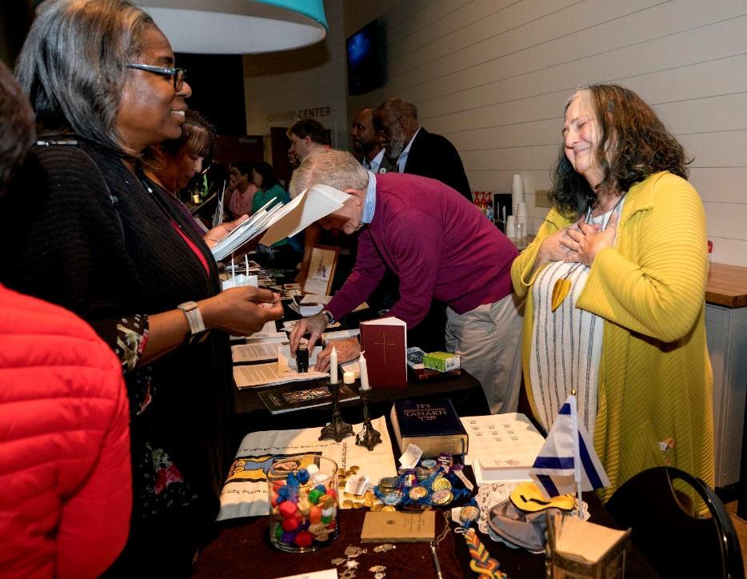
Feeling included in the marketplace
Please think of a time in your organization when you felt really included, like you belonged.
What makes this moment stand out?
Notes:
https://www.postandcourier.com/moultrie-news/news/business/mount-pleasant-chamber-of-commerce-holds-membership-drive/article_b77a2bf1-1bec-5186-a80a-4333f5e9266e.html

Slide 19






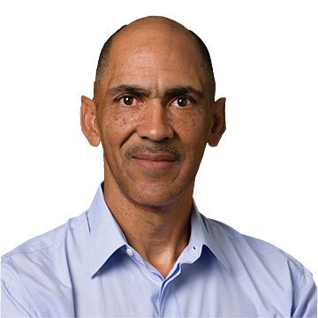


The Fertilizer…Ubuntic Inclusion™

Slide 20
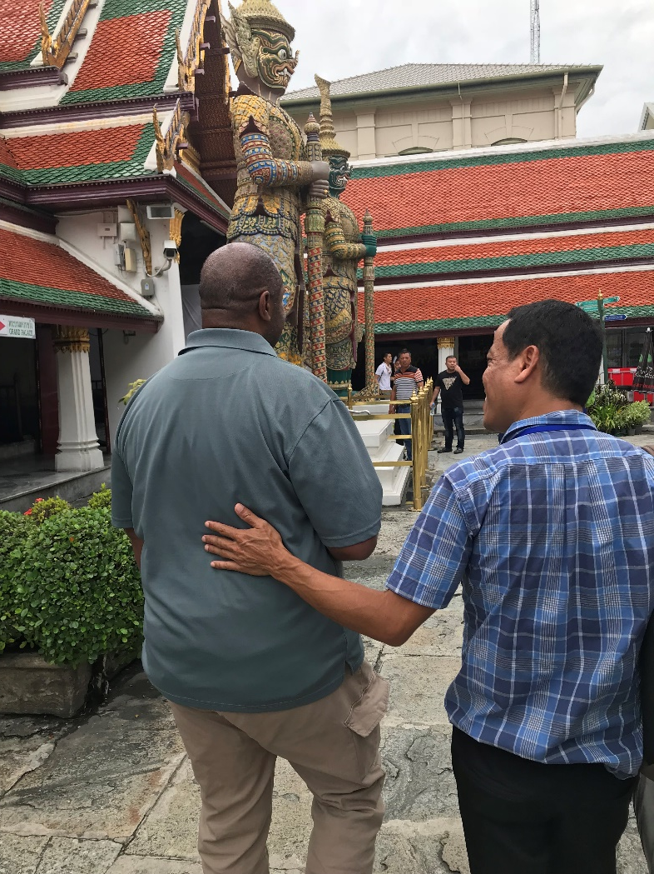
What’s next?
What are other times you’ve felt included? Which dimensions of Ubuntic Inclusion™ were involved?
If you don’t feel included often, what dimensions are missing?
What are you willing to learn? to do differently?
What can you do to make others feel included?
How does inclusion impact your work experience?
How can you be a lifelong learner?
Notes:
https://interestingengineering.com/generation-alpha-the-children-of-the-millennial
https://www.forbes.com/sites/christinecarter/2016/12/21/the-complete-guide-to-generation-alpha-the-children-of-millennials/#1a038ef03623

Slide 21
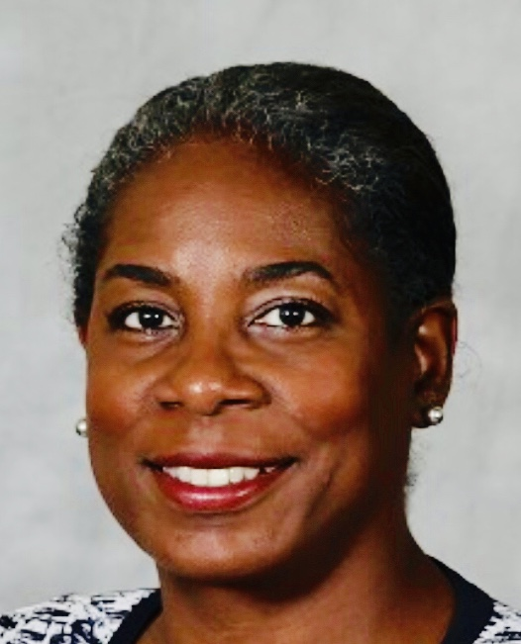
Dr. J. Goosby Smith * DrJGoosbySmith@gmail.com Do justice. Love mercy. Walk humbly.
Here’s the help I’m looking for…
How can we make inclusion an every-day part of our lives (and not just something we address when bad things happen)?
What is a valuable lesson that you learned from someone who differs from you along one of the dimensions of diversity that we covered today?

